Slide 1

Movie Recommendation System Using Apache Spark and Python
#1
End-to-end Big Data Project To Build A Movie Recommendation System Using
Apache Spark and Python.
Final Project Status Report
BRIGHT KYEREMEH

Slide 2
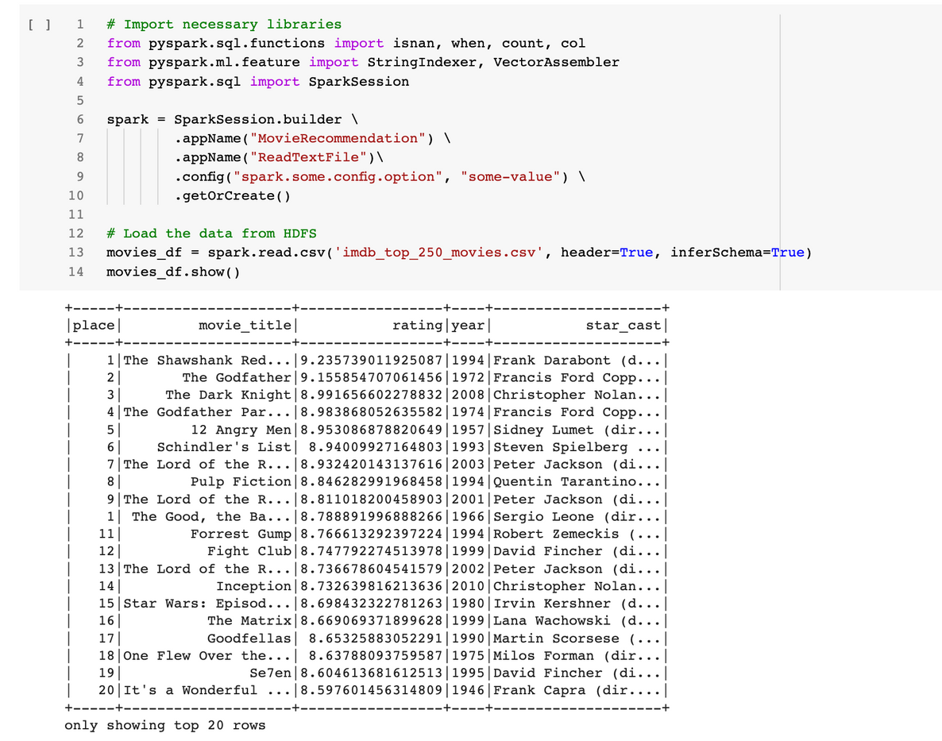
sample dataset output
STEPS
Data Extraction
The data to be used for this project will come from the IMDB database.
01
The dataset is first extracted from the IMDB website via python libraries such as beautiful soup. The dataset is then saved and load from HDFS into spark dataframe.
Loading and exploring data
02
BRIGHT KYEREMEH

Slide 3
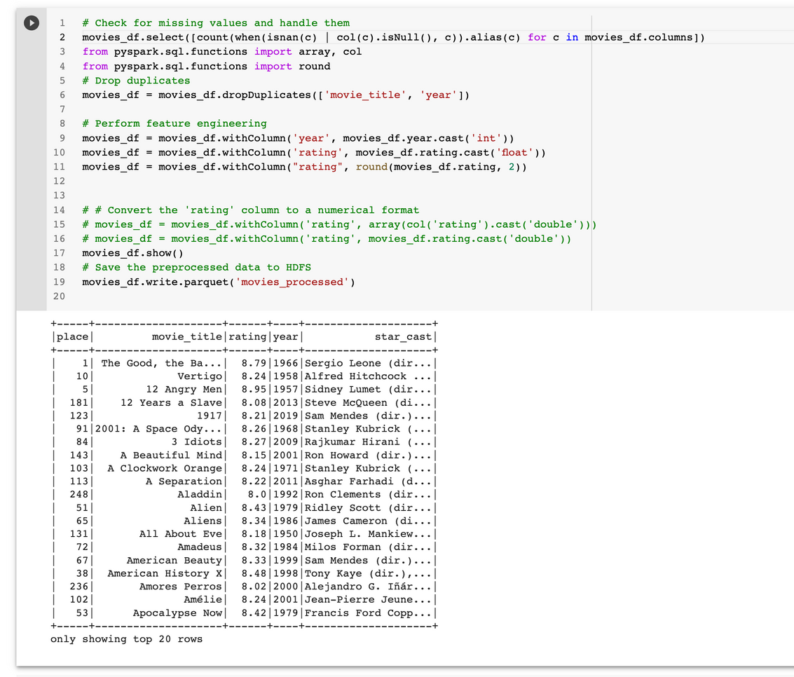
sample dataset output
STEPS
The dataset is then check for:
missing values
dropping duplicate values
feature engineered the year and rating
saved the processed file
Data Preparation
03
BRIGHT KYEREMEH

Slide 4
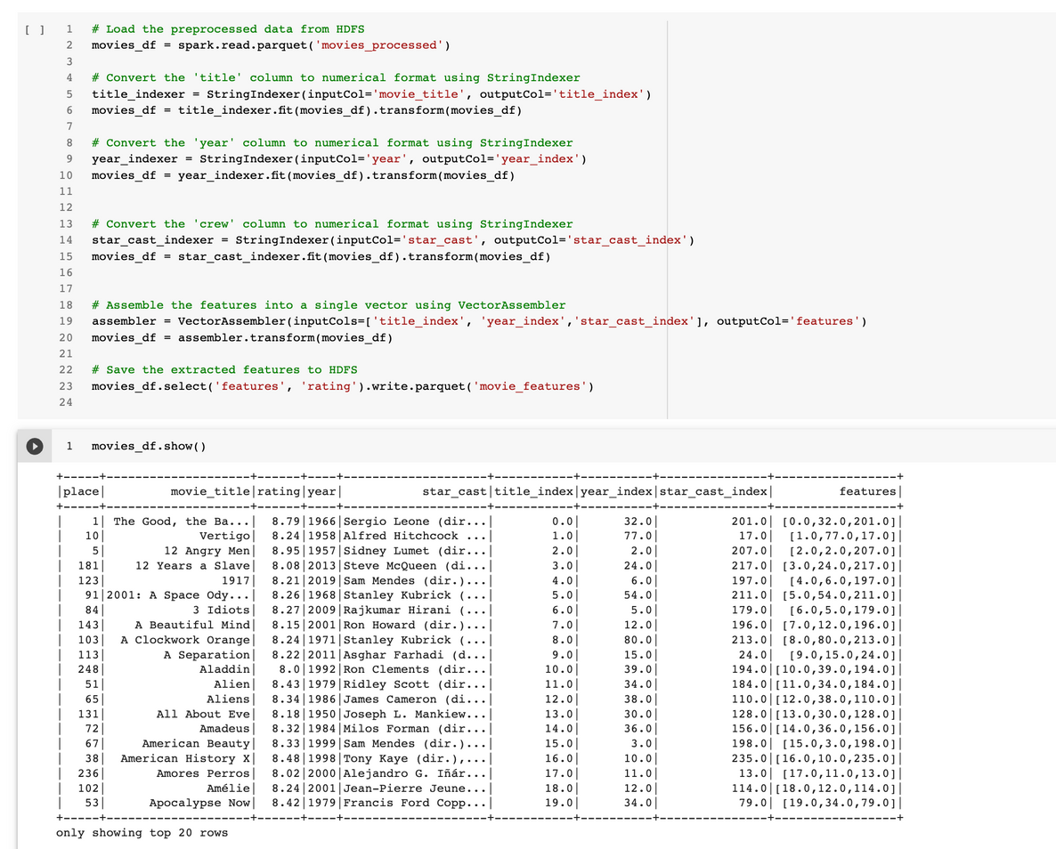
sample dataset output
STEPS
Here we create a column called "feature" which contains index values for the movie titles, year and crew. We will based on this feature to build a recommendation model using Alternating Least Squares (ALS) in pyspark or any other ML algorithm that will work best during the model building stage.
Further feature engineering
04
BRIGHT KYEREMEH

Slide 5
Movie Recommendation System Using Apache Spark and Python
#2
End-to-end Big Data Project To Build A Movie Recommendation System Using
Apache Spark and Python.
Final Project Status Report
BRIGHT KYEREMEH

Slide 6
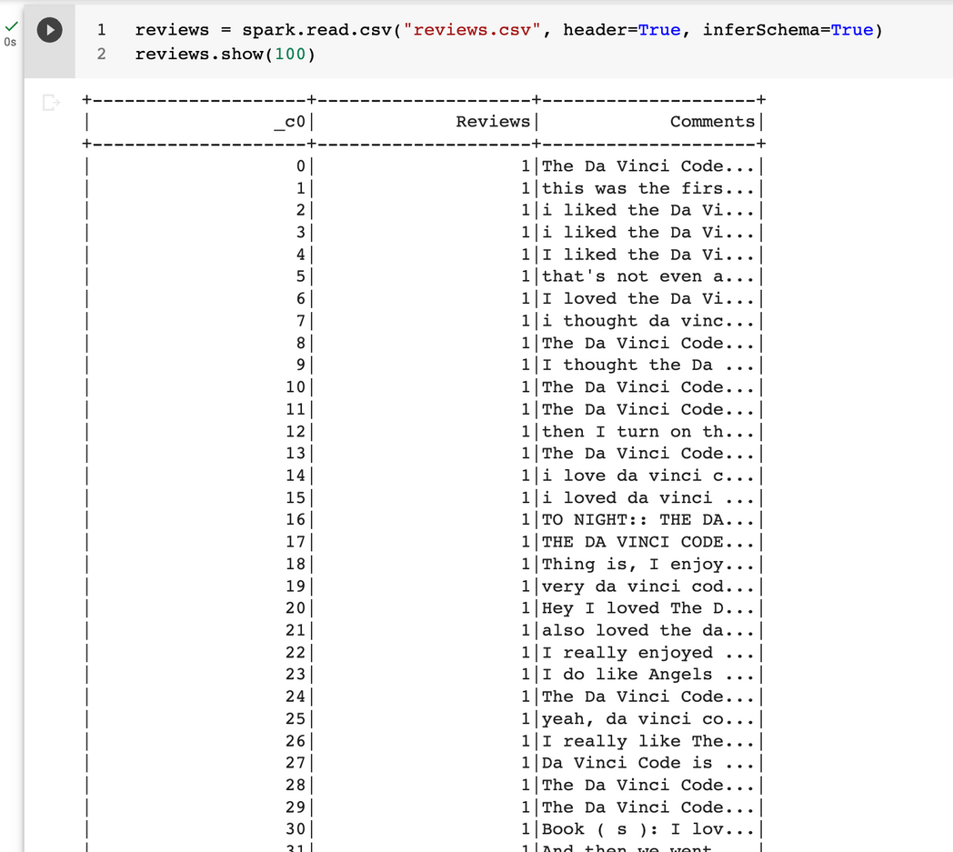
sample dataset output
STEPS
Extracted Reviews from IMDB
Reviews for the various movies have been extracted for performing sentiment analysis.
01
BRIGHT KYEREMEH

Slide 7
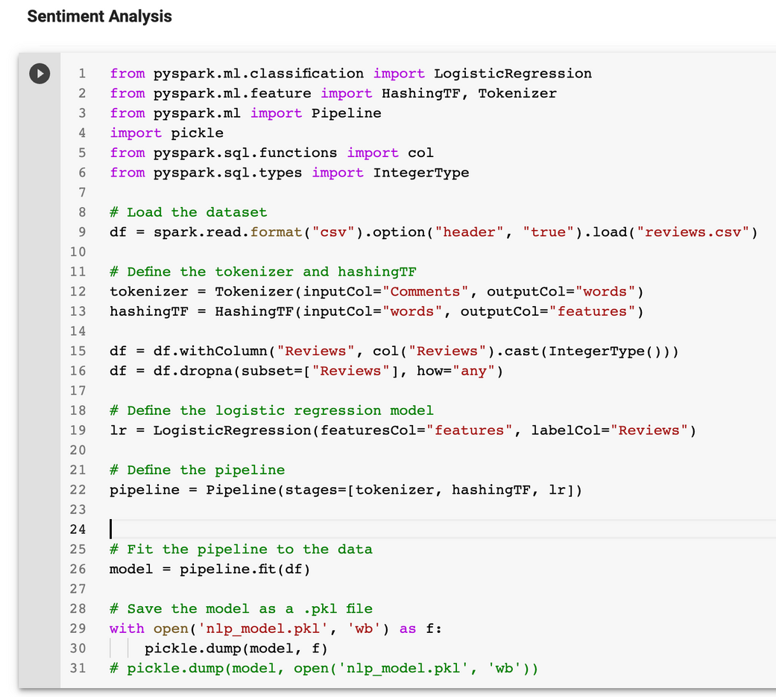
Sample Code
STEPS
I used the reviews and comments to build a sentiment analyzer and saved the model which will be incorporated in the movie recommendation app
Building a Sentiment Analyzer
01
BRIGHT KYEREMEH

Slide 8
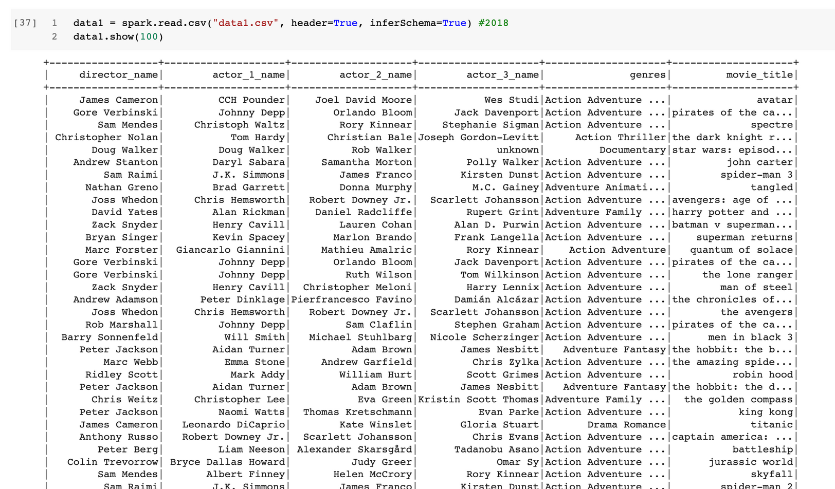
sample dataset output
2018 Data
STEPS
More and current data has been extracted to include data on directors, actors genres and movie titles
Extracted more data from IMDB
01
BRIGHT KYEREMEH

Slide 9
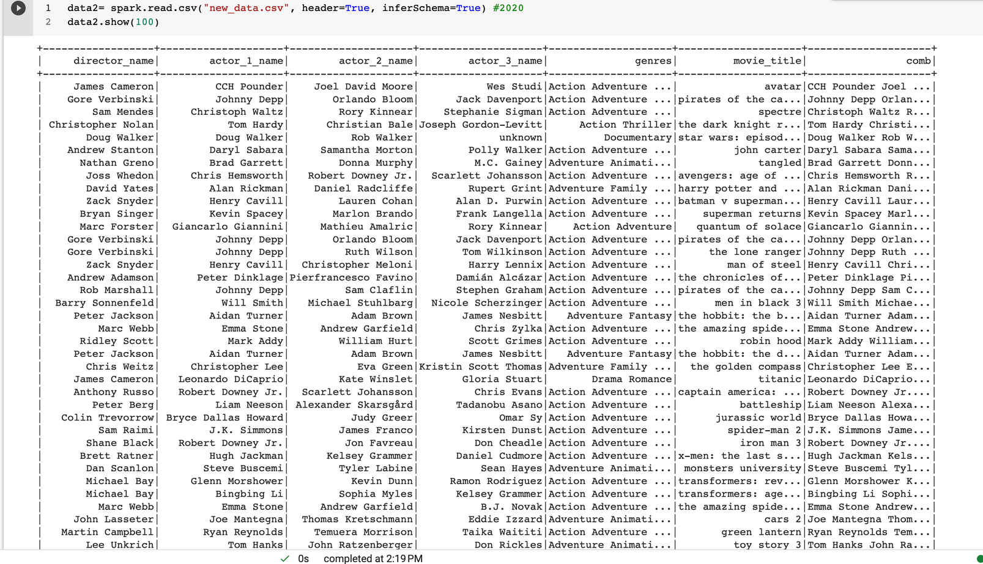
sample dataset output
2019 Data
STEPS
More and current data has been extracted to include data on directors, actors genres and movie titles
Extracted more data from IMDB
01
BRIGHT KYEREMEH

Slide 10
Task
Using TFIDF to create a vectorizer
I will be using TfidfVectorizer to create a vectorizer which will be used when creating the main.py in flask for processing all the extracted data
01
NEXT STEPS
I will need to create the necessary files such as:
main.py
requirement.txt
static (for css)
templates (for html)
02
Preparing for deployment
02
Deploy Model
Finally deploy the model via python flask
BRIGHT KYEREMEH

Slide 11
Week 1: Data collection
Week 2 : Data preprocessing
Week 3: Performing feature extraction
Week 4: Building machine learning using PySpark's MLlib
Week 5: Evaluating and tuning the model for best performance
Week 6: Deployment and integration of the model using Python flask or Heroku cloud or other cloud platforms as described above
Weekly Schedule
BRIGHT KYEREMEH

